Slide 1
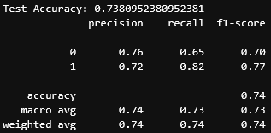

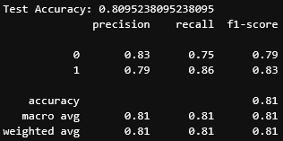
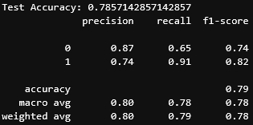
Diarmuid O’Neill – C00282898 – 21/04/26
Forward feature selection
2 most correlated features
Non-Linear SVM using forward feature selection and tuning
4 most correlated features

Slide 2
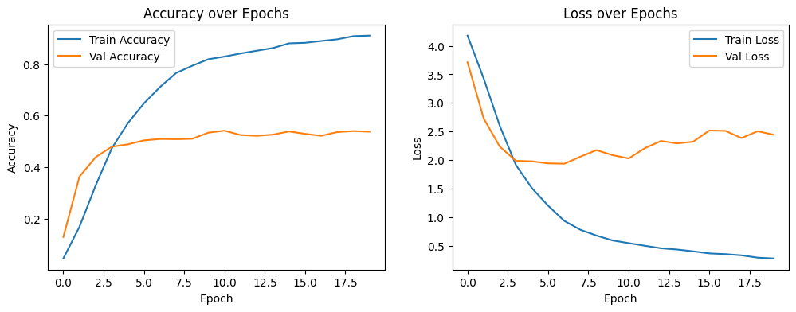

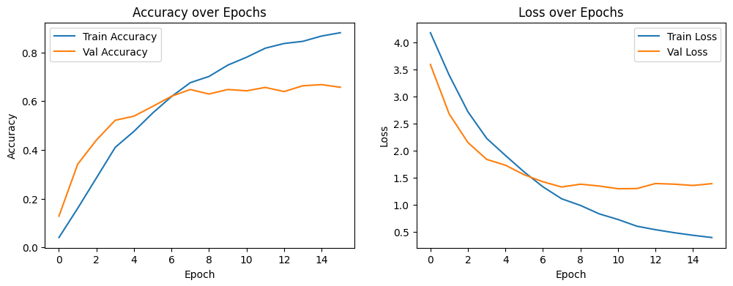

3 Layers (32/64/128)
Dense Layer (128)
Dropout (0.5)
3 Layers (80/160/320)
Dense Layer (640)
Dropout (0.7)
EarlyStopping function

Slide 3
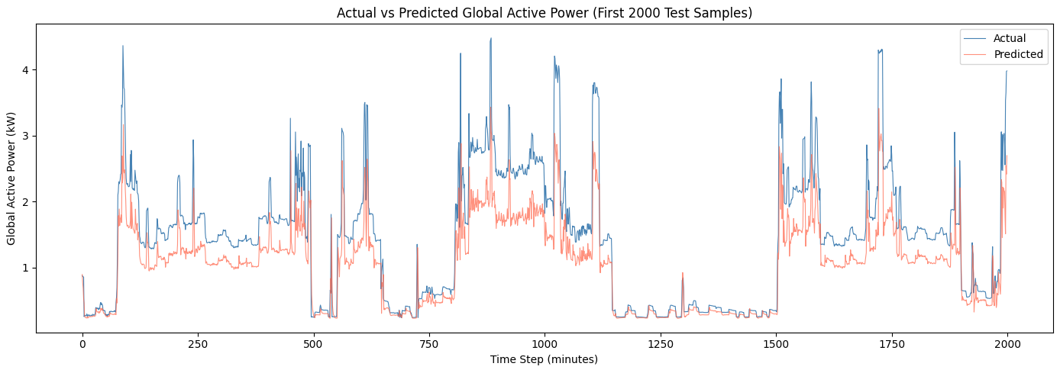

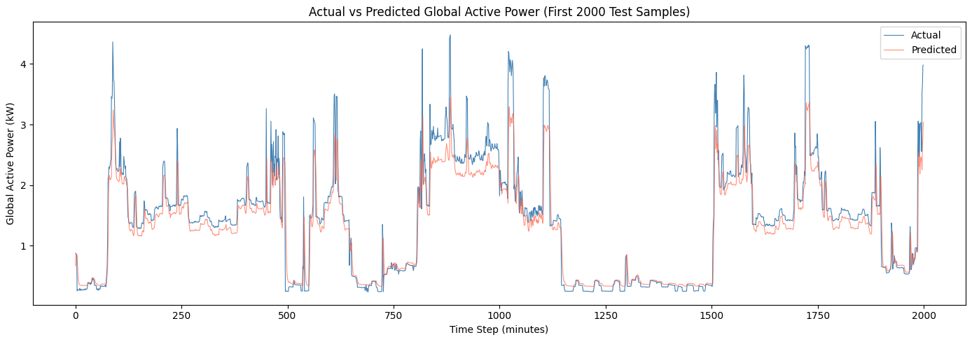

Layer 1 (64)
Layer 2 (32)
Dropout (0.2)
Dense (16)
Layer 1 (32)
Layer 2 (16)
Dropout (0.3)
Dense (8)
EarlyStopping

